Slide 1
Databases
Sanket Singh SWE 2 @ Google

Slide 2
What will you learn
DB Reliability
DB Replication
Sync and Async updates

Slide 3
Can the DB server be a Single point of failure?
If we have only one instance of DB server, then it can be a SPOF.

Slide 4
How to resolve this ?

Slide 5
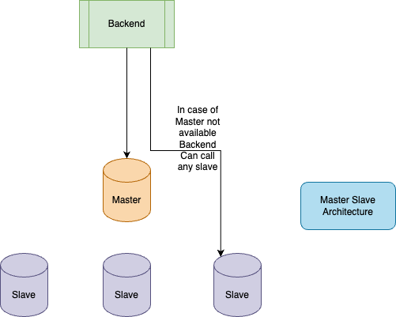
Replication can come handy !!

Slide 6
Benefits of Replication
Reduction in Latency
We can reduce latency in multiple ways, for example if we have a cross country call then we can have multiple replicas in different geo locations.

Slide 7
What about writes ?
Read in replication is not that of an issue currently.
How to handle writes ?

Slide 8
Synchronous Update
This mechanism says that, if let’s say leader gets an update, then we will not immediately send a response back to the user.
Instead we will first write on all the replicas, and once write is done on all the replicas then only we will send the response back to the user.
In banking apps we need synchronous updates can be used.

Slide 9
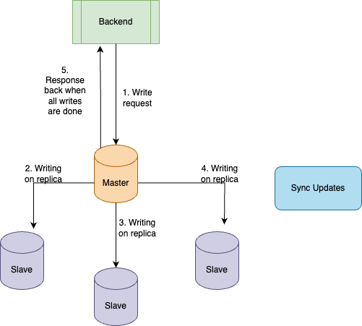

Slide 10
Synchronous Update Issues
System becomes less available because if even one replica is down we won’t be sending the response back to the user.
Write latency increases to a high extent.

Slide 11
Asynchronous Update
In Async update, we will not wait for replicas to be updated immediately, but instead when the leader is done with the write, we send the response back to the user.
Later with some scheduled process we can update the replicas one by one later

Slide 12
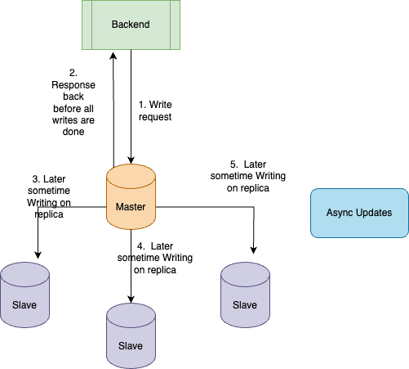

Slide 13
Asynchronous Update Issues
Say we did a write on leader, and before the replicas could have been synced, the leader dies.
Now this can cause permanent loss of data.
Consistency drop too much. This violates durability, as we might have informed the user that something is stored but then it will be lost.
Replication lag can also be an issue, because some people if they are reading from the replica might see old data.

Slide 14
Let’s Consider A Scenario
Let’s say we are building a Reminder As A Service
We can make a note of a meeting
We can ask for our meetings
We can ask for a reminder 5 min before our meeting

Slide 15
Let’s Say We Have One Person In The Team
Initially we have a low scale let’s assume we are able to handle everything via a single person.
But what happens when the scale increases ?

Slide 16
Now Let’s Say We Deploy One More Teammate
We now have two people in the team who are handling the load.
What can go wrong here ?

Slide 17
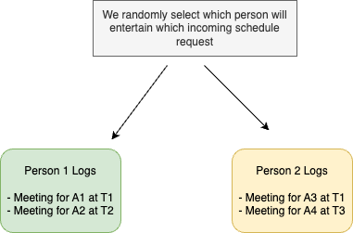
Scenario 1:
Say both of the team mates maintain separate log for what all meetings are scheduled
Say Person 1 gets a call to schedule the meeting, then person 1 notes it down.
Same thing is done by Person 2.

Slide 18
What are the problems ?
Say we have Customer 1, and If we sent the scheduling call of Customer 1 to person 1 where Person 1 notes it down in their log, but as we are randomly sending the requests , we sent the check my schedule request of Customer 1 to Person 2, then Person 2 won’t be having any idea about the scheduling.
This is a classical Consistency problem.
Notes:
If you’re writing data at two diff places and read can happen from anywhere then this will cause an issue

Slide 19
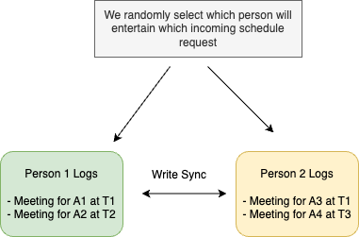
Any solution ?
What if we setup a mechanism such that, whenever Person 1 takes a note , it is going to inform Person 2 that we have a new write request, same will be done by Person 2.

Slide 20
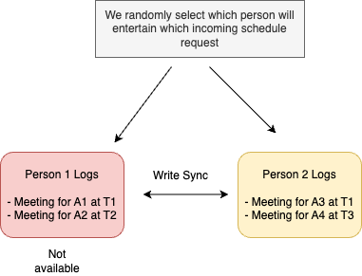
But is there any issue ?
This mechanism can create Availability problem as if any one person is not available, then the other one won’t be taking new reminder requests, otherwise consistency will be
hampered.
And if we stop taking new request
then availability of the system
hampers.

Slide 21
Any solution ?
Say, we won’t stop taking new reminder requests.
And whenever the person who was not available comes online again, they have to sync their logs with the other persons who were already online.
This way we will not be having consistency problem, as when the person who was offline was not having updated info, no user request also will be redirected to it.

Slide 22
Any issues that can still come ?
What if there is an issue with the sync logic between the persons.
May be they are not able to communicate.
This can happen due to network partition.
This is called Problem of Partition.

